Slide 1
Project Planning
Research and Development Skills in Computing
Lecture 4
Understanding the process and different stages of a project
This lecture and its associated materials have been produced by Mr. Sanjiv Udash (MSc, University of Northampton) of iAcademy for the purposes of lecturing on the above described subject and the material should be viewed in this context. The work does not constitute professional advice and no warranties are made regarding the information presented. The Author and iAcademy do not accept any liability for the consequences of any action taken as a result of the work or any recommendations made or inferred. Permission to use any of these materials must be first granted by iAcademy.

Slide 2
Agenda
Week 4 Lecture Coverage
  Project Process
  Project Stages
  Project Definition (Aims and Objectives)
  Project Planning
  Risk Management

Slide 3
But first let’s review what have we learned from week 3

Slide 4
Review of Week 3
Need to be careful while choosing a project
Consider things like scope, usefulness, future prospect
Understand the different aspects of the proposal while writing it
Know your supervisor well before selecting him/her

Slide 5

Any Confusion?

Slide 6
The project’s stages (1)
From a project management perspective, all projects progress through five main stages during their lifetime; from the time the project is established as an initial idea to the time the project is finally completed.
These stages apply to all kinds of projects; from your own academic computing project to large industrial projects spanning several years.

Slide 7
The project’s stages (2)
The five main stages are:
  1. Definition
  2. Planning
  3. Initiation
  4. Control
  5. Closure.

Slide 8
1. Project Definition: Definition (1)
The purpose of project definition is to clearly specify what it is you hope to achieve with your project
This stage initially includes deciding on your project and putting together a proposal
In many ways your project definition and your initial project proposal are closely linked.
Both should be written at the start of your project and, while your proposal aims to get your project accepted, your definition will help to clarify what it is you are really setting out to achieve.

Slide 9
1. Project Definition: Definition (2)
Your project definition must identify the aims and objectives of your intended work.
Defining your project in this way is important for a number of reasons;
  If you have difficulty defining your project in terms of aims and objectives then you will have difficulty deciding on the work you ought to be doing and what your focus will be.
  It might also mean that your understanding of the subject area is lacking and you need to do some additional preliminary research in the topic area or, more drastically, choose an alternative project.

Slide 10
1. Project Definition: Definition (3)
  It gives you a clear target for which to aim. This provides a continual reference point against which you can assess your progress.
  It provides you with a means of evaluating your success at the end. For example, did you achieve all that you intended to do or more?

Slide 11
1. Project Definition: Defining your aims (1)
Your project should be defined at two levels. At the top level you define your project’s aim or goal.
All projects have one major aim that they hope to achieve and your computing project is no exception.
If you are ever in any doubt over what work you ought to be doing or which direction you ought to be taking, you can refer to your project’s aim to guide you.

Slide 12
1. Project Definition: Defining your aims (2)
Example:
  to evaluate the effectiveness of requirements capture techniques in small software development companies in Nepal;
  to develop and evaluate a user interface for statistical software packages;
  to design a methodology for GUI development of technical courseware material;
  to investigate and produce an evaluation of fourth generation languages for database
  development.

Slide 13
1. Project Definition: Setting objectives (1)
Objectives identify significant measurable achievements you hope to make that build towards the ultimate aim of your project.
Having identified and defined your project’s aim you should continue to define your project in terms of its objectives.
For a project expected to last approximately one year, you wouldn’t expect to identify more than twelve objectives for your project.

Slide 14
1. Project Definition: Setting objectives (2)
If your project has more objectives than this it may be that you are attempting to do too much or that you are breaking your project down into too much detail.
Take, as an example, a computing project that is going to evaluate artificial neural networks for predicting stock market indices (not an easy task!). You might identify the following aims and objectives for this project.

Slide 15
1. Project Definition: Setting objectives (3)
Project’s Aim:
  Develop and evaluate an Artificial Neural Network to predict stock market indices.
Project’s Objectives:
  Complete a literature search and literature review of existing stock market prediction techniques.
  Develop a suitable artificial neural network model.
  Identify and collect data for analysis/evaluation.
  Evaluate the model using appropriate statistical techniques.
  Complete final report.

Slide 16
1. Project Definition: SMART objectives
There are a number of definitions of the SMART acronym, the most applicable to student projects being:
  Specific
  Measurable
  Appropriate
  Realistic
  Time-Related.
For each of the objectives you identify in your project you should apply these criteria to ensure that those objectives are clearly defined.

Slide 17
2. Project Planning (1)
Although you are now clear about what you intend to achieve with your project, what you must now do is identify the work you need to do in order to fulfil these aims.
Project planning assists you by identifying the work you need to perform, clarifying the order in which you should tackle the work, and revealing how long you need to do it.
It is at this point that you may realize that your project is either overly complex or of insufficient depth for the requirements of your course.

Slide 18
2. Project Planning (2)
Project planning is performed through a series of six steps that utilize a number of project management techniques:
  Work breakdown
  Time estimates
  Milestone identification
  Activity sequencing
  Scheduling
  Re-planning.

Slide 19
2. Project Planning: Work Breakdown (1)
Work breakdown structures (WBSs) are used to break your project down into lower and lower levels of detail to reveal exactly what work you will need to do to complete your project.
You should begin a WBS by breaking your project down into its main objectives that you identified during your project’s definition.

Slide 20
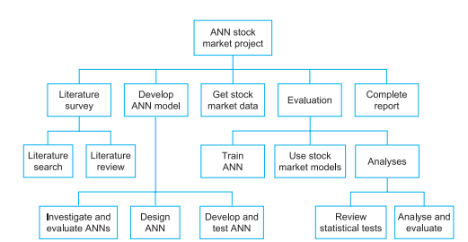
2. Project Planning: Work Breakdown (2)

Slide 21
2. Project Planning: Time estimates(1)
When a project’s aims and objectives are identified it provides little indication of exactly how long the project will take to complete.
You would hope that your project is of a suitable scope to keep you busy during the allotted time and is of sufficient depth for you to obtain a good grade.
However, it is not until you break the project down using a WBS that you really begin to see just how much work is involved.

Slide 22
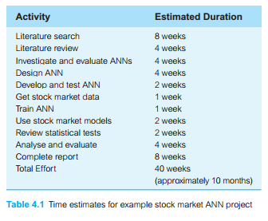
2. Project Planning: Time estimates(2)
Now that the project is broken down into a number of tasks it is much easier to estimate how long the project will take.

Slide 23
2. Project Planning: Identify milestones (1)
Milestones are significant steps towards the completion of a project.
They help you to appreciate your progress by providing you with intermediate reference points.
This enables you to assess, at the earliest opportunity, how you are progressing against your planned schedule.

Slide 24
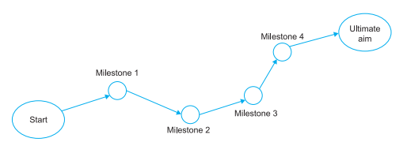
2. Project Planning: Identify milestones (2)
Because you know these milestones are leading you towards the ultimate goal of your project you can use these as intermediate goals at which to aim.

Slide 25
2. Project Planning: Activity sequencing (1)
An activity network can now be used to identify the order in which you should perform that work.
Activity networks were first developed towards the end of the 1950s and are sometimes referred to as PERT networks, CPM or network diagrams.
Two forms of activity network were developed at that time – Activity-on-the-arrow networks and activity-on-the-node networks.

Slide 26
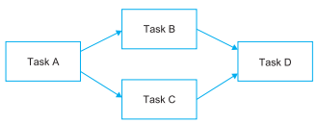
2. Project Planning: Activity sequencing (2)

Slide 27
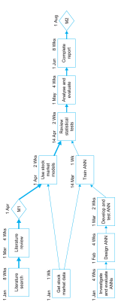
2. Project Planning: Activity sequencing (3)

Slide 28
2. Project Planning: Scheduling (1)
Gantt charts are similar to activity networks in that they attempt to represent a project in diagrammatical form.
However, unlike activity networks, they do not show the relationships between tasks, but they do explicitly show the durations of activities and identify instances when tasks are performed simultaneously.
Just like activity-on-the-node networks, Gantt charts represent a project’s activities as rectangles or nodes, and milestones by diamonds.

Slide 29
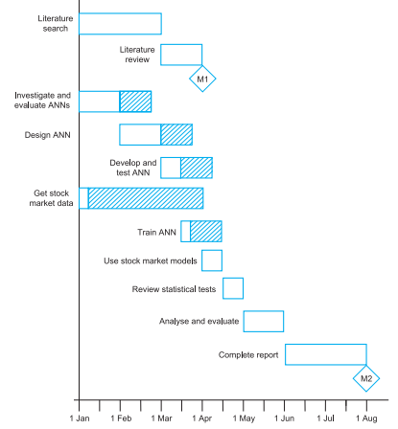
2. Project Planning: Scheduling (2)
In this case, however, the size (length) of an activity’s node represents the duration of that activity.

Slide 30
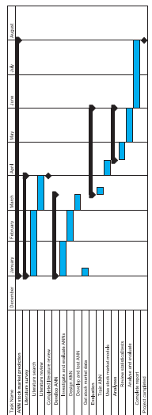
2. Project Planning: Scheduling (3)

Slide 31
2. Project Planning: Re-planning
Now that you have completed all your plans, you may realize you are trying to do too much in the time available.
Re-planning simply means that you go back through your plans, adjusting and rescheduling them accordingly.
Project management software tools are particularly useful for making these changes and assessing the impact of your adjustments.
However, try not to spend too long on this stage or you may find yourself re-planning and rescheduling than getting on with the ‘real’ work

Slide 32
Risk Management (1)
Risk management is a process that is inexorably linked to project management; it runs in parallel with project management and follows a very similar process.
Just as project management involves the development of a project plan and control of the project using that plan as the project progresses, risk management involves the identification of risks at the project’s outset and the control of those risks as the project unfolds.

Slide 33
Risk Management (2)
The four main stages of this risk management process are:
  Identify risks
  Assess impact of risks
  Alleviate critical risks
  Control risks.

Slide 34
Risk Management: identify risks (1)
As you are putting together your project plan, you should also be identifying any sources of risk to your project.
These risks can be:
  individual events (event-driven risks – acute) that might have an impact on your project (for example, your supervisor leaving, your hard disk crashing, etc.) or
  they may be longer term risks that evolve over time (evolving risks – chronic) before eventually coming to a head (for example, underestimating the time it will take you to develop part of your system, deteriorating relationship with your client, etc.).

Slide 35
Risk Management: identify risks (2)
Whether the risks to your project are event-driven or evolving, they can be further classified as either technical or non-technical risks.
Technical risks refer to any risks that are associated with the hardware or software you might be using.
Non-technical risks are all other risks associated with your project. These can include such things as:
  losing your client, your user or your supervisor; illness; over-running your time estimates; discovering work during your literature search that already covers (in depth) what you intended to do; etc.

Slide 36
Risk Management: identify risks (3)
As well as identifying potential risks to your project it is also useful to identify risk triggers (risk symptoms) at this stage too.
Risk triggers are events or things that happen during the course of your project that might give an indication that something is wrong or that one of the risks you have identified is increasingly likely to occur.
All projects encounter problems to some extent, so don’t be disheartened if some of the risks you identify during this stage of the risk management process occur.

Slide 37
Risk Management: access impact of risks (1)
Having identified the risks associated with your project in the first stage of the risk management process, you should then calculate their impact.
The impact of any risk on your project is given by the following equation:
Risk impact = likelihood X consequence
Thus, although a risk may be highly likely to occur, if its consequences are low its impact will also be low.

Slide 38
Risk Management: access impact of risks (2)
Similarly, if a risk has severe consequences for your project but its chances of happening are very low, its impact is also calculated as low.
The risks you need to worry about are those that are highly likely to occur and have significant consequences to your project if they do.

Slide 39
Risk Management: alleviate critical risks
There are three ways that you can deal with the critical risks you have identified in your project: avoidance, deflection(transfer) and
Avoidance means reducing the chances that the risk will occur at all.
Deflection means passing the risk onto someone or something else.
Contingency means accepting that the risk is going to occur and putting something in place to deal with it when it does. contingency.

Slide 40
Risk Management: control risks
You have now identified all the risks in your project. This is not the end of the process; you cannot just sit back and relax.
While risk management can make you aware of the risks involved and put things in place to deal with those risks, it does not take away the risks to your project entirely.
The last stage of the risk management process is concerned with planning your risk strategy approach, monitoring risks as your project progresses and dealing with those risks if they occur.

Slide 41

Any Questions?

Slide 42
Summary: Week 4 Lecture
The five main stages are:
  Definition
  Planning
  Initiation
  Control
  Closure
The four main stages of this risk management process are:
  Identify risks
  Assess impact of risks
  Alleviate critical risks
  Control risks.

Slide 43
What to Expect: Week 4 Activities
  Task: Developing an initial plan for the project and looking into potential risks and their solutions

Slide 44


